Slide 1
Computer Interfacing CSE360
Md. Khalilur Rhaman
Associate Professor
CSE Department
BRAC University

Slide 2
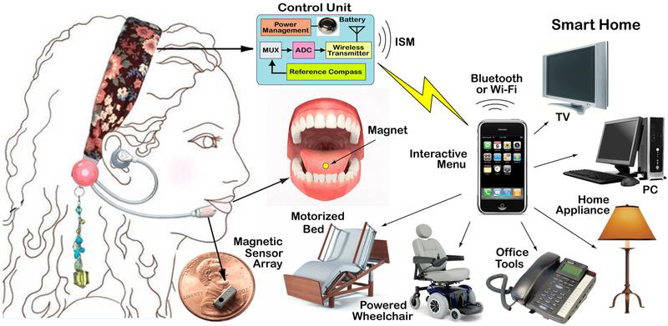
Interfacing Concept

Slide 3
Computer Interfacing
Peripheral Device (Input)
Interface
CPU
Peripheral Device (Output)
Interface

Slide 4
Computing System Architecture
Computer
Main Memory
(RAM & ROM)
Peripheral
Devices
CPU
Peripheral
Devices
Interfacing
Interfacing
ALU
CU
Registers
Interfacing
Communication and Secondary Devices

Slide 5
Hardware Interfacing Architecture
Communication
Interfacing
Interfacing
Interfacing
High End Input
Interfacing
High End Processor Computer
Interfacing
High End Output
Sensor Input
Micro-Controller
Display, Sound or Motor Action
Calibration Circuit
Driver / Controller
Power

Slide 6
Course outline
Computer interfacing
Computer interfacing IC
Introduction to Low level programing language
Low level IO
Techniques of sensing and sensors and their Interfacing
GPIO
Communication Protocols
Interfacing concept of hardware for output devices
Recently arrived processing devices which can be used for computer interfacing
Human Computer Interfacing
Brain Computer Interfacing
Design and implement a project on computer interfacing

Slide 7
Project
Design and Implementation of an Interfacing Systems
Processing should be done in Computer
Micro-controller/ Raspberry PI/ Arduino can be used as an interfacing IC
At least 3 Sensors and two Output. The output can be trade with one Sensor
Report writing
Demo presentation

Slide 8
Catch me in
By email:
khalilur@bracu.ac.bd
khalilur@gmail.com
Whatsapp or SMS: 01752042223
Phone Call (in case of VERY argent): 01752042223
FACEBOOK, MESSENGER, SKYPE, VIBER etc. are restricted for students to communicate with me

Slide 9
Marks Distribution
Attendance: 5%
Quiz: 15 %
Assignments: 10 %
Lab and project: 20 %
Midterm: 20 %
Final: 30%
Total: 100

